Slide 1
Design and Analysis of Algorithms
National University of Computer and Emerging Sciences, Islamabad

Slide 2
Special Types of Trees
Def: Full binary tree = a binary tree in which each node is either a leaf or has degree exactly 2.
Def: Complete binary tree = a binary tree in which all leaves are on the same level and all internal nodes have degree 2.
4
1
3
2
16
9
10
14
8
7
12
Full binary tree
4
1
3
2
16
9
10
Complete binary tree

Slide 3
Definitions
Height of a node = the number of edges on the longest simple path from the node down to a leaf
Level of a node = the length of a path from the root to the node
Height of tree = height of root node
4
Height of root = 3
1
3
Height of (2)= 1
2
16
9
10
Level of (10)= 2
14
8

Slide 4
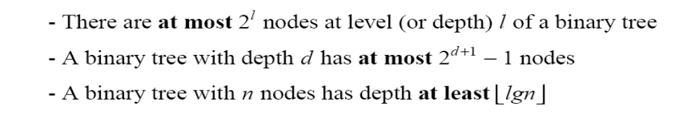
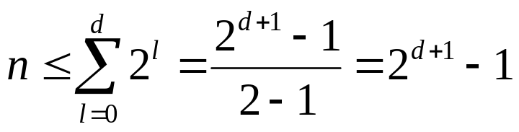
Useful Properties
height
height
4
Height of root = 3
1
3
Height of (2)= 1
2
16
9
10
Level of (10)= 2
14
8

Slide 5
The Heap Data Structure
Def: A heap is a nearly complete binary tree with the following two properties:
  Structural property: all levels are full, except possibly the last one, which is filled from left to right
  Order (heap) property: for any node x
  Parent(x) ≥ x
8
From the heap property, it follows that:
“The root is the maximum
element of the heap!”
7
4
5
2
Heap
A heap is a binary tree that is filled in order

Slide 6
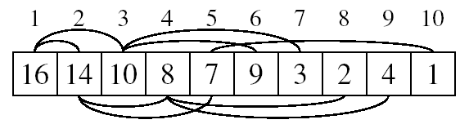
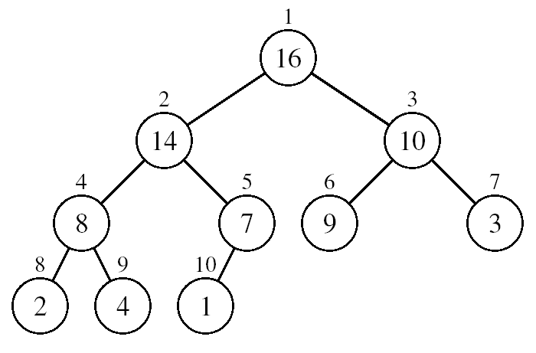
Array Representation of Heaps
A heap can be stored as an array A.
  Root of tree is A[1]
  Left child of A[i] = A[2i]
  Right child of A[i] = A[2i+1]
  Parent of A[i] = A[ ⎣i/2⎦ ]
  Heapsize[A] ≤ length[A]
The elements in the subarray A[(⎣n/2⎦+1) .. n] are leaves

Slide 7
Heap Types
Max-heaps (largest element at root), have the max-heap property:
  for all nodes i, excluding the root:
  A[PARENT(i)] ≥ A[i]
Min-heaps (smallest element at root), have the min-heap property:
  for all nodes i, excluding the root:
  A[PARENT(i)] ≤ A[i]

Slide 8
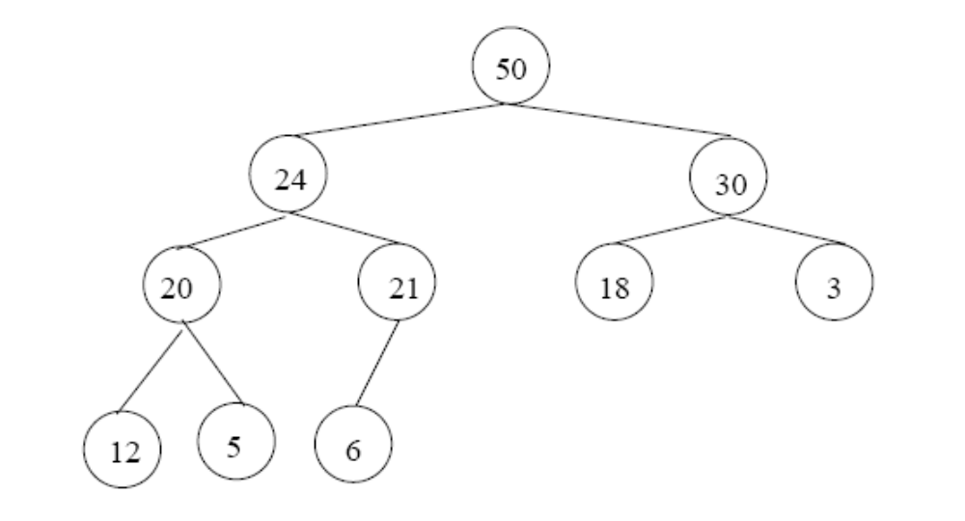
Adding/Deleting Nodes
New nodes are always inserted at the bottom level (left to right)
Nodes are removed from the bottom level (right to left)

Slide 9
Operations on Heaps
Maintain/Restore the max-heap property
  MAX-HEAPIFY
Create a max-heap from an unordered array
  BUILD-MAX-HEAP
Sort an array in place
  HEAPSORT
Priority queues

Slide 10
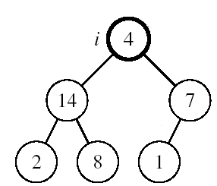
Maintaining the Heap Property
Suppose a node is smaller than a child
  Left and Right subtrees of i are max-heaps
To eliminate the violation:
  Exchange with larger child
  Move down the tree
  Continue until node is not smaller than children

Slide 11
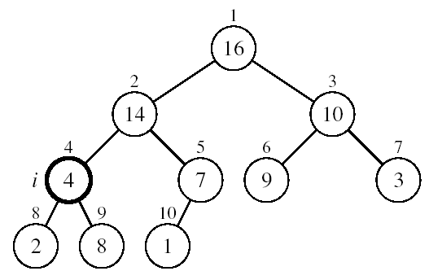
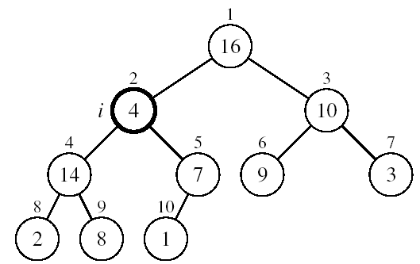
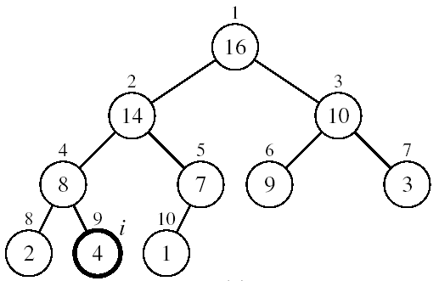
Example
MAX-HEAPIFY(A, 2, 10)
A[2] ↔ A[4]
A[2] violates the heap property
A[4] violates the heap property
A[4] ↔ A[9]
Heap property restored

Slide 12
Maintaining the Heap Property
Alg: MAX-HEAPIFY(A, i, n)
l ← LEFT(i)
r ← RIGHT(i)
if l ≤ n and A[l] > A[i]
then largest ←l
else largest ←i
if r ≤ n and A[r] > A[largest]
then largest ←r
if largest ≠ i
then exchange A[i] ↔ A[largest]
MAX-HEAPIFY(A, largest, n)
Assumptions:
  Left and Right subtrees of i are max-heaps
  A[i] may be smaller than its children

Slide 13
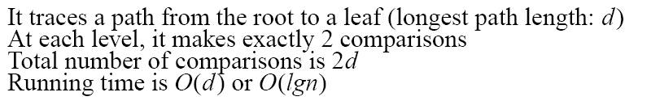
MAX-HEAPIFY Running Time
Intuitively:
Running time of MAX-HEAPIFY is O(lgn)
Can be written in terms of the height of the heap, as being O(h)
  Since the height of the heap is ⎣lgn⎦
-
h
-
-
-
2h
O(h)

Slide 14
Building a Heap
Convert an array A[1 … n] into a max-heap (n = length[A])
The elements in the subarray A[(⎣n/2⎦+1) .. n] are leaves
Apply MAX-HEAPIFY on elements between 1 and ⎣n/2⎦
1
Alg: BUILD-MAX-HEAP(A)
n = length[A]
for i ← ⎣n/2⎦ downto 1
do MAX-HEAPIFY(A, i, n)
4
2
3
1
3
4
5
6
7
2
16
9
10
8
9
10
14
8
7
A:
4 | 1 | 3 | 2 | 16 | 9 | 10 | 14 | 8 | 7

Slide 15
Example: A
4 | 1 | 3 | 2 | 16 | 9 | 10 | 14 | 8 | 7
i = 5
i = 4
i = 3
1
1
1
4
4
4
2
3
2
3
2
3
1
3
1
3
1
3
4
5
6
7
4
5
6
7
4
5
6
7
2
16
9
10
2
16
9
10
14
16
9
10
8
9
10
8
9
10
8
9
10
14
8
7
14
8
7
2
8
7
i = 2
i = 1
1
1
1
4
4
16
2
3
2
3
2
3
1
10
16
10
14
10
4
5
6
7
4
5
6
7
4
5
6
7
14
16
9
3
14
7
9
3
8
7
9
3
8
9
10
8
9
10
8
9
10
2
8
7
2
8
1
2
4
1

Slide 16
Complexity of BUILD MAX HEAP
Alg: BUILD-MAX-HEAP(A)
n = length[A]
for i ← ⎣n/2⎦ downto 1
do MAX-HEAPIFY(A, i, n)
O(n)
O(lgn)
⇒ Running time: O(nlgn)?

Slide 17
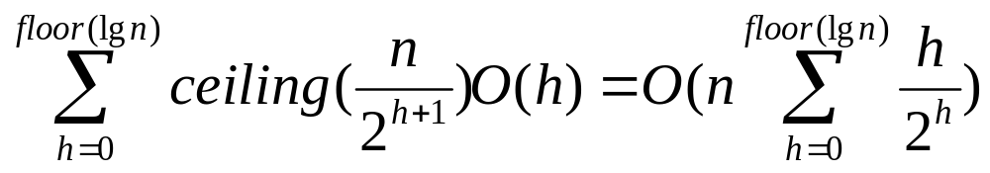
Complexity of Build-Max-Heap
1. Each call to Max-Heapify costs O(log n) time, there are O(n)
such calls. Thus, the complexity is O(n log n)?
2. Tighter analysis results in the complexity of O(n).
The time required by Max-Heapify when called on a node of height h is O(h), and so we can express the total cost of Build-Max-Heap as being bounded by

Slide 18
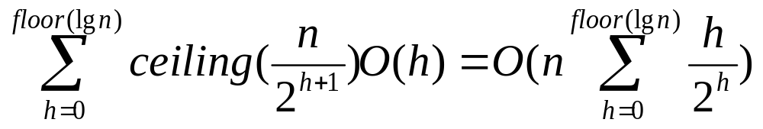
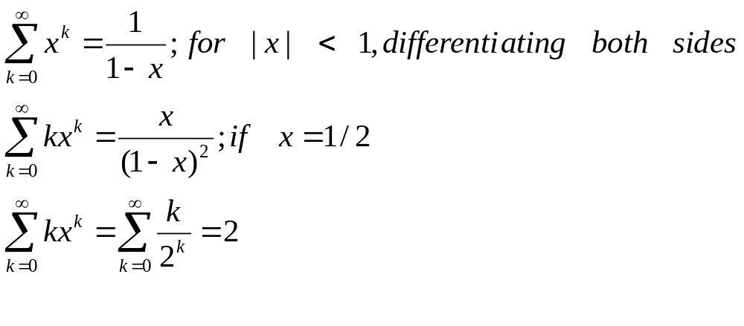
Complexity of Build-Max-Heap
Thus,
= O(n)

Slide 19
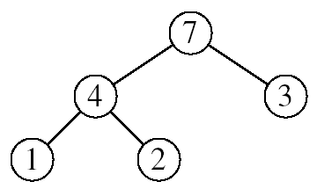
Heapsort
Goal:
  Sort an array using heap representations
Idea:
  Build a max-heap from the array
  Swap the root (the maximum element) with the last element in the array
  “Discard” this last node by decreasing the heap size
  Call MAX-HEAPIFY on the new root
  Repeat this process until only one node remains

Slide 20
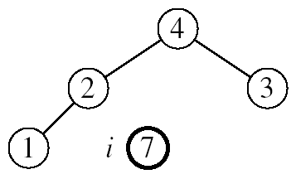
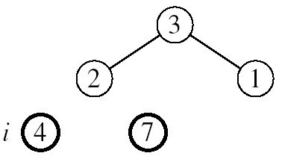
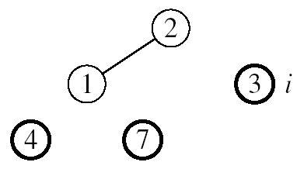
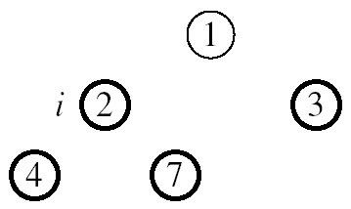

Example: A=[7, 4, 3, 1, 2]
MAX-HEAPIFY(A, 1, 4)
MAX-HEAPIFY(A, 1, 3)
MAX-HEAPIFY(A, 1, 2)
MAX-HEAPIFY(A, 1, 1)

Slide 21
Alg: HEAPSORT(A)
BUILD-MAX-HEAP(A)
for i ← length[A] downto 2
do exchange A[1] ↔A[i]
MAX-HEAPIFY(A, 1, i - 1)
Running time: O(nlgn)
O(n)
n-1 times
O(lgn)

